Slide 1
Prepositions
Level 2

Slide 2
What is a “Preposition” anyway?
A preposition links nouns, pronouns, and phrases to other words in a sentence.
A preposition usually tells where or when something is or where it came from.
The name "preposition" (pre + position) means "place before". Prepositions usually come *before* another word, usually a noun.

Slide 3


Examples
  The book is on the table.
  The book is beneath the table.
  The book is leaning against the table.
  The book is beside the table.
  She held the book over the table.
  She read the book during class.

Slide 4
And now there is a “Prepositional Phrase” too?
A prepositional phrase is made up of the preposition, its object and any associated adjectives or adverbs. A prepositional phrase can function as a noun, an adjective, or an adverb.

Slide 5
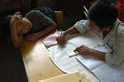
Preposition List
aboard
about
above
across
after
against
along
amid
among
anti
around
as
at
despite
down
during
except
excepting
Excluding
following
for
from
in
inside
into
like
minus
near
of
off
on
onto
opposite
outside
over
past
per
plus
before
behind
below
beneath
beside
besides
between
beyond
but
by
concerning
considering

Slide 6
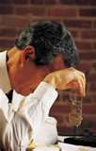
… and a few more…
than
through
to
toward
towards
under
underneath
unlike
until
up
upon

Slide 7

…okay last few!…
versus
via
with
within
without

Slide 8
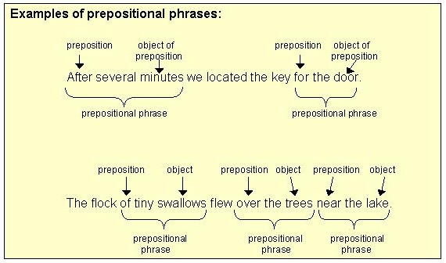

Slide 9
~Let’s Find Some Prepositions~
You can sit before the desk (or in front of the desk). The professor can sit on the desk (when he's being informal) or behind the desk, and then his feet are under the desk or beneath the desk. He can stand beside the desk (meaning next to the desk), before the desk, between the desk and you, or even on the desk (if he's really strange). If he's clumsy, he can bump into the desk or try to walk through the desk (and stuff would fall off the desk). Passing his hands over the desk or resting his elbows upon the desk, he often looks across the desk and speaks of the desk or concerning the desk as if there were nothing else like the desk.

Slide 10
You can sit before the desk (or in front of the desk). The professor can sit on the desk (when he's being informal) or behind the desk, and then his feet are under the desk or beneath the desk. He can stand beside the desk (meaning next to the desk), before the desk, between the desk and you, or even on the desk (if he's really strange). If he's clumsy, he can bump into the desk or try to walk through the desk (and stuff would fall off the desk). Passing his hands over the desk or resting his elbows upon the desk, he often looks across the desk and speaks of the desk or concerning the desk as if there were nothing else like the desk.
20
http://iaenglish8.blogspot.com/2007/11/prepositional-phrase-activity-ii.html

Slide 11
Some Practice
1. http://a4esl.org/q/h/0101/es-prepositions.html
2. http://impact-english.com/members/Grammar_Practice/Always/test-grammar/gr_prac_preps-gen.htm
3. http://impact-english.com/members/Grammar_Practice/Always/test-grammar/gr_prac_prep-phrases-bus.htm

